Slide 1
Welcome
Welcome everyone to today's webinar on advanced AI algorithms for image analysis.
I'm Braun Brelin, the Managing Director of Ai-Elevate and I'll be guiding you through this session.
Thank you for joining us today.

Slide 2
Objectives
Introduce advanced AI algorithms for image analysis:
Today, we will explore some of the more advanced techniques in AI that are particularly useful for analyzing images, especially from space telescopes.
Discuss practical applications in space telescope data analysis:
We will look at how these advanced algorithms are applied in real-world scenarios, particularly in analyzing data from space telescopes.

Slide 3
Objectives
Provide a foundational understanding of several key algorithms:
We will cover several important algorithms including:
Variational Autoencoders (VARs): Useful for generating new data and understanding complex datasets.
Generative Adversarial Networks (GANs): Powerful for creating realistic synthetic data.

Slide 4
Objectives
U-Net architecture: Widely used for precise image segmentation, especially in biomedical and astronomical fields

Slide 5
Overview:
We will start with a brief review of Convolutional Neural Networks to ensure everyone is on the same page.
Introduction to advanced AI techniques:
After the recap, we'll introduce the advanced techniques mentioned earlier.
Deep dive into selected algorithms:
We'll take a closer look at a few key algorithms, discussing their theoretical background and practical applications.

Slide 6
Overview:
Practical examples and case studies:
To make things concrete, we'll look at practical examples and case studies, including code snippets and walkthroughs.
Q&A session:
Finally, we'll conclude with a Q&A session where you can ask any questions you have about the material covered.

Slide 7
Convolutional Neural Networks (CNNs)
Key Components:
Convolutions: Feature extraction
Pooling: Dimensionality reduction
Activation Functions: Non-linearity
Diagram 1. Example of convolving window with CNN’s.
Notes:
Convolutional Neural Networks (CNNs)
Let's start with a quick recap of Convolutional Neural Networks, or CNNs. CNNs are a class of deep learning models commonly used for analyzing visual data. They have revolutionized the field of computer vision and are the foundation for many image analysis tasks.
Key Component:
Convolutions:
Convolutions are the core building blocks of CNNs. They involve applying a set of filters to the input data to extract important features. For instance, in the context of image analysis, convolutions can help detect edges, textures, and other patterns that are crucial for recognizing objects within an image. Each filter slides over the input image, performing a dot product operation, which results in a feature map. These feature maps highlight different aspects of the image, enabling the network to learn and identify complex patterns.

Slide 8
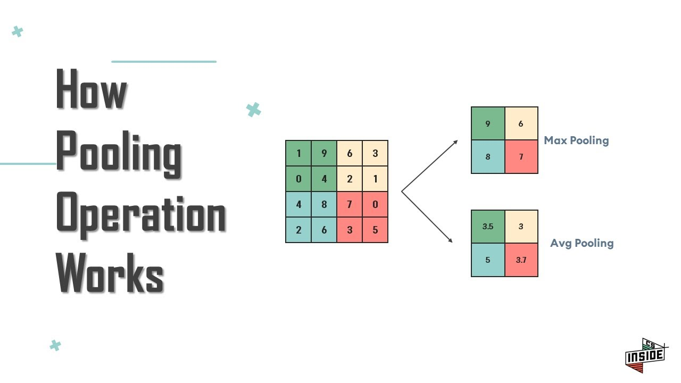
Convolutional Neural Networks (CNNs)
Key Components:
Convolutions: Feature extraction
Pooling: Dimensionality reduction
Activation Functions: Non-linearity
Diagram 2. Example of pooling with CNN’s.
Notes:
Convolutional Neural Networks (CNNs)
Key Component:
Pooling:
Pooling layers are used to reduce the dimensionality of the data, making the model more computationally efficient and less prone to overfitting. There are different types of pooling, with the most common being max pooling and average pooling. In max pooling, the maximum value within a certain window is taken, while in average pooling, the average value is calculated. By downsampling the feature maps, pooling layers help retain the most significant features while discarding less important information, thus simplifying the data.

Slide 9
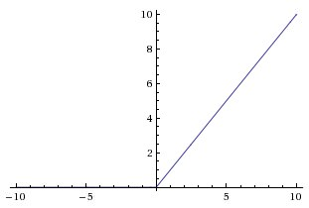
Convolutional Neural Networks (CNNs)
Key Components:
Convolutions: Feature extraction
Pooling: Dimensionality reduction
Activation Functions: Non-linearity
Diagram 3. Example of the ReLU activation functions.
Notes:
Convolutional Neural Networks (CNNs)
Let's start with a quick recap of Convolutional Neural Networks, or CNNs. CNNs are a class of deep learning models commonly used for analyzing visual data. They have revolutionized the field of computer vision and are the foundation for many image analysis tasks.
Key Components:
Activation Functions:
Activation functions introduce non-linearity into the model, allowing it to learn and represent complex patterns. Without activation functions, the network would be limited to learning only linear relationships. Common activation functions include ReLU (Rectified Linear Unit), sigmoid, and tanh. ReLU is particularly popular because it helps mitigate the vanishing gradient problem and accelerates the training process by allowing gradients to propagate more effectively.
Applications:
CNNs have a wide range of applications in image analysis. One of the most prominent applications is image classification, where the goal is to assign labels to images. For example, a CNN can be trained to recognize and classify objects such as cats, dogs, and cars in photos. Another important application is object detection, which involves locating and identifying multiple objects within an image. This is particularly useful in scenarios like autonomous driving, where identifying various objects on the road is crucial for safety. Lastly, image segmentation is another key application of CNNs. In image segmentation, an image is divided into segments or regions, allowing for more detailed analysis. This is useful in medical imaging, where different anatomical structures need to be identified and analyzed separately.

Slide 10
Convolutional Neural Networks (CNNs)
Limitations:
Difficulty in handling sequential data
Limited ability to focus on important parts of the input
Challenges in generating realistic data
Examples:
Temporal changes in satellite imagery
Image captioning for complex scenes
Notes:
Limitations:
Traditional Convolutional Neural Networks (CNNs) have several limitations that restrict their effectiveness in certain tasks.
Difficulty in Handling Sequential Data:
One significant limitation is their inability to effectively handle sequential data. CNNs are designed to process spatial data, such as images, where the relationship between pixels in a single frame is crucial. However, they struggle with temporal data where the order of data points is important, such as in video analysis or time-series forecasting. For example, understanding how a sequence of satellite images changes over time to track environmental changes requires models that can capture temporal dependencies, which traditional CNNs are not well-suited for.
Limited Ability to Focus on Important Parts of the Input:
Another limitation of CNNs is their limited ability to focus on important parts of the input. Traditional CNNs treat all parts of the input image with equal importance, which can be inefficient. In many cases, only certain regions of an image are relevant for a particular task. For instance, when generating a caption for an image, some parts of the image may contain crucial information, while others are irrelevant. This is where attention mechanisms and transformers come into play, allowing the network to focus on the most relevant parts of the input.
Challenges in Generating Realistic Data:
Lastly, CNNs face challenges in generating realistic data. While they are excellent at recognizing patterns and features in images, they are not inherently designed to create new, realistic images. Generating high-quality synthetic images requires more sophisticated models, such as Generative Adversarial Networks (GANs). GANs involve a generator and a discriminator network working in tandem to produce realistic images, which is beyond the capability of traditional CNNs alone.
Examples:
To illustrate these limitations, consider the following examples:
Temporal Changes in Satellite Imagery:
Traditional CNNs struggle with tasks that involve analyzing changes over time. For example, monitoring environmental changes through a sequence of satellite images requires understanding how the imagery evolves. This temporal aspect is crucial for detecting phenomena like deforestation, urbanization, or seasonal changes, which traditional CNNs are not equipped to handle effectively.
Image Captioning for Complex Scenes:
When it comes to generating captions for images, traditional CNNs can identify objects but fail to capture the contextual importance of different regions within the image. Complex scenes often contain multiple objects and intricate details that need to be described accurately. Attention mechanisms allow the network to focus on specific parts of the image, improving the quality and relevance of the generated captions.
These limitations highlight the need for more advanced AI techniques, which we will explore in the upcoming slides. Understanding these constraints sets the stage for why techniques like attention mechanisms, transformers, Variable AutoEncoders and GANs have been developed and are essential for more complex image analysis tasks.

Slide 11
Overview of Advanced AI Techniques
Introduction:
VAEs: Variational Autoencoders
GANs: Generative Adversarial Networks
Attention Mechanisms and Transformers
U-Net: Convolutional network for image segmentation
Notes:
Introduction:
In the previous slides, we discussed the limitations of traditional CNNs. Now, let's look at some advanced AI techniques that address these limitations and enable more sophisticated image analysis.
VAEs (Variational Autoencoders):
Variational Autoencoders, or VAEs, are a type of generative model that can learn to encode data into a latent space and then decode it back to the original data space. This process allows VAEs to generate new, similar data points and is useful for tasks like data augmentation and anomaly detection. By learning a probabilistic distribution of the data, VAEs can generate realistic variations of input images, which is particularly useful in scenarios where obtaining large amounts of data is challenging.
GANs (Generative Adversarial Networks):
Generative Adversarial Networks, or GANs, consist of two networks: a generator and a discriminator. The generator creates synthetic images, while the discriminator evaluates their realism. This adversarial process helps GANs produce highly realistic images. GANs have been used for tasks such as creating realistic photos from textual descriptions, generating high-resolution images from low-resolution inputs, and even producing artwork. They are particularly powerful in applications where generating new, realistic data is crucial.
Attention Mechanisms and Transformers:
Attention mechanisms allow models to focus on the most relevant parts of the input data. This is particularly useful in tasks where certain regions of an image or parts of a sequence are more important than others. Transformers, which are built on attention mechanisms, have revolutionized natural language processing and are increasingly being applied to image analysis tasks as well. They excel in tasks such as image captioning, where the model needs to generate a coherent description of an image by focusing on different regions sequentially.
U-Net:
U-Net is a convolutional network architecture specifically designed for image segmentation. It was initially developed for biomedical image segmentation but has been widely adopted in other fields, including astronomy. U-Net's architecture allows for precise localization and segmentation of objects within an image, making it ideal for tasks like identifying galaxies, stars, and other celestial objects in astronomical images.

Slide 12
Overview of Advanced AI Techniques
Applications:
Enhancing telescope images
Image captioning
Segmentation of astronomical images
Notes:
Applications:
These advanced AI techniques have a wide range of applications, particularly in the field of image analysis:
Enhancing Telescope Images:
Techniques like denoising autoencoders and GANs can be used to enhance the quality of telescope images, removing noise and improving clarity, which is crucial for accurate interpretation.
Image Captioning:
Attention mechanisms and transformers enable models to generate detailed and accurate descriptions of images, making them useful for tasks like automatic annotation of telescope images.
Segmentation of Astronomical Images:
U-Net and other segmentation models allow for precise identification and segmentation of celestial objects, aiding in the analysis and classification of astronomical data.

Slide 13
Autoencoders and Denoising Autoencoders Mechanisms
Autoencoders:
Unsupervised learning
Feature learning and dimensionality reduction
Notes:
Autoencoders:
Autoencoders are a type of neural network used for unsupervised learning. They consist of two main components: the encoder and the decoder. The encoder compresses the input data into a lower-dimensional representation, known as the latent space, capturing the most important features of the data. The decoder then reconstructs the original data from this compact representation. This process helps in learning efficient data representations and performing dimensionality reduction.
Applications:
Autoencoders are particularly useful for tasks such as feature extraction, anomaly detection, and dimensionality reduction. By compressing the data, autoencoders can uncover underlying patterns and structures, making them valuable for various machine learning applications.

Slide 14
Denoising Autoencoders:
Learning to reconstruct input from noisy versions
Enhancing image quality
Notes:
Autoencoders:
Autoencoders are a type of neural network used for unsupervised learning. They consist of two main components: the encoder and the decoder. The encoder compresses the input data into a lower-dimensional representation, known as the latent space, capturing the most important features of the data. The decoder then reconstructs the original data from this compact representation. This process helps in learning efficient data representations and performing dimensionality reduction.
Applications:
Autoencoders are particularly useful for tasks such as feature extraction, anomaly detection, and dimensionality reduction. By compressing the data, autoencoders can uncover underlying patterns and structures, making them valuable for various machine learning applications.

Slide 15
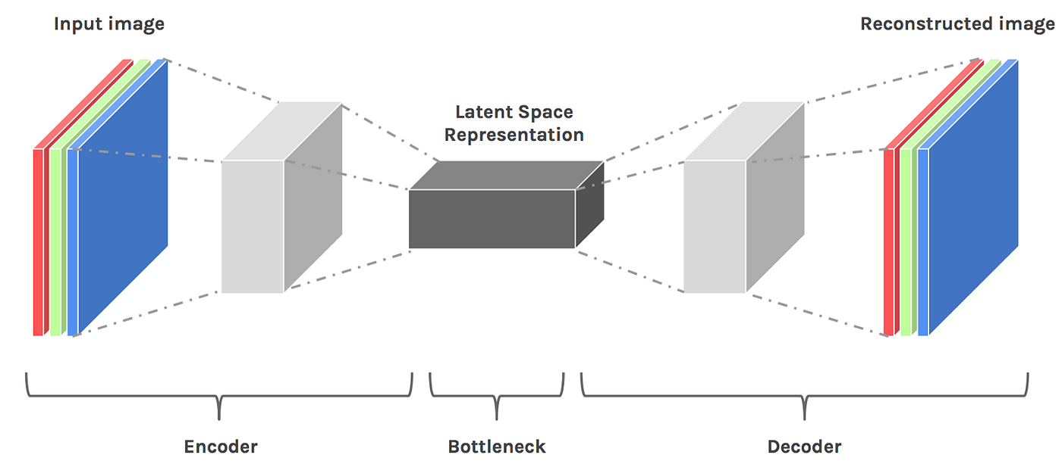
Variational Autoencoders (VAEs)
Theoretical Background:
Latent space representation
Probabilistic graphical models
Diagram 4. Architecture of a VAE.
Notes:
Theoretical Background:
Variational Autoencoders, or VARs, are a type of generative model that learn to encode input data into a lower-dimensional latent space and then decode it back to the original data space. The key idea behind VARs is to learn a probabilistic distribution of the input data, allowing the model to generate new data points that are similar to the original data.
VARs consist of two main components: the encoder and the decoder. The encoder maps the input data to a latent space, typically represented by a mean and variance. This latent space captures the essential features of the data in a compact form. The decoder then reconstructs the data from this latent space. By sampling from the learned distribution, VARs can generate new data points that are similar to those in the training set.
One of the strengths of VARs is their ability to handle uncertainty and variability in the data. By using probabilistic graphical models, VARs can learn complex distributions and generate realistic variations of the input data.

Slide 16
Concept of Latent Space
Theoretical Background:
Latent space representation
Probabilistic graphical models

Slide 17
Concept of Latent Space
Latent Representation:
Latent space refers to a compressed representation of the input data. Instead of representing data in its original high-dimensional form, latent space captures the most important features in a lower-dimensional form.
The idea is to map the input data into a space where similar data points are closer together, and different data points are farther apart. This space is learned during the training process.

Slide 18
Encoding and Decoding
Encoder:
The encoder is a neural network that takes the input data and compresses it into the latent space.
For example, in the case of images, the encoder might map a high-dimensional image (e.g., 28x28 pixels, which is 784 dimensions) into a lower-dimensional latent vector (e.g., 2 or 10 dimensions).
The encoder learns to capture the essential features of the data, discarding the less important details.

Slide 19
Encoding and Decoding
Latent Vector:
The output of the encoder is a latent vector, which represents the input data in the latent space. Each point in the latent space corresponds to a different feature or characteristic of the input data.
In a VAE, the latent vector is typically represented by a mean vector and a variance vector, indicating the distribution from which to sample the latent variables.

Slide 20
Encoding and Decoding
Decoder:
The decoder is another neural network that takes the latent vector and reconstructs the original data.
The decoder learns to interpret the compressed information and generate data that resembles the original input.
The goal of the decoder is to minimize the difference between the original input data and the reconstructed data.

Slide 21
Variational Autoencoders (VAEs)
Probabilistic Nature:
In VAEs, the encoder does not just produce a single point in the latent space but a distribution (mean and variance). This allows for the sampling of different points from this distribution, enabling the generation of new, similar data points.
The loss function in VAEs includes a reconstruction loss (difference between original and reconstructed data) and a regularization loss (ensuring the latent space distribution is close to a standard normal distribution).

Slide 22
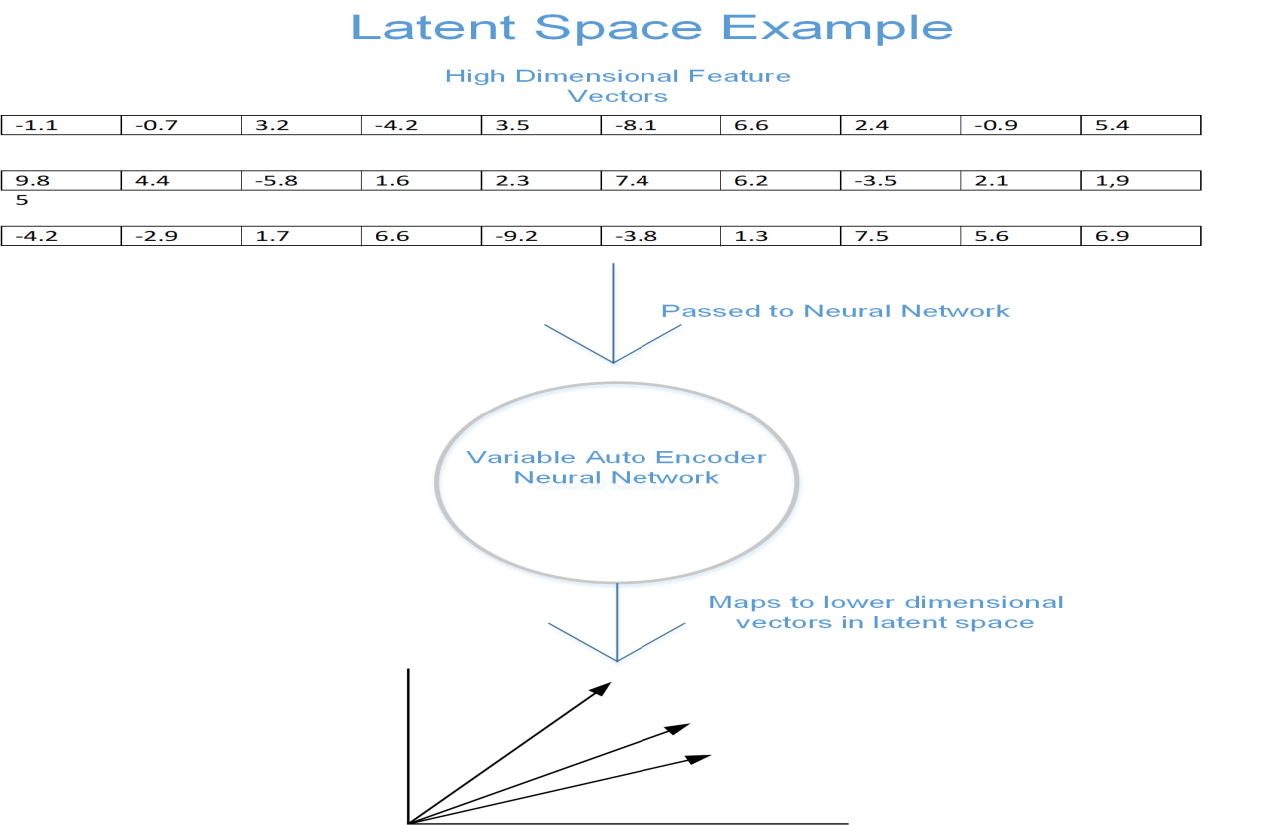
Visualizing Latent Space
Diagram 5. A simple representation of Latent Spaces.

Slide 23
Visualizing Latent Space
Manifold Learning:
Latent spaces can be visualized as manifolds where each point corresponds to a possible input data point. For example, in the case of images, each point in the latent space might correspond to a different variation of the image (e.g., different rotations or scales).
By navigating through the latent space, we can generate variations of the input data, which is particularly useful for tasks like data augmentation.
Notes:
Example: Handwritten Digits
Consider an example with handwritten digits (e.g., the MNIST dataset):
Input Image: A 28x28 pixel image of a handwritten digit.
Encoder: Compresses the 784-dimensional input into a 2-dimensional latent space.
Latent Vector: Each point in the 2D space represents a different digit, capturing essential features like stroke width and orientation.
Decoder: Reconstructs the original 28x28 image from the 2D latent vector.
By sampling different points in the latent space, the decoder can generate new images of digits that resemble the ones in the original dataset, demonstrating the generative capability of the VAE.

Slide 24
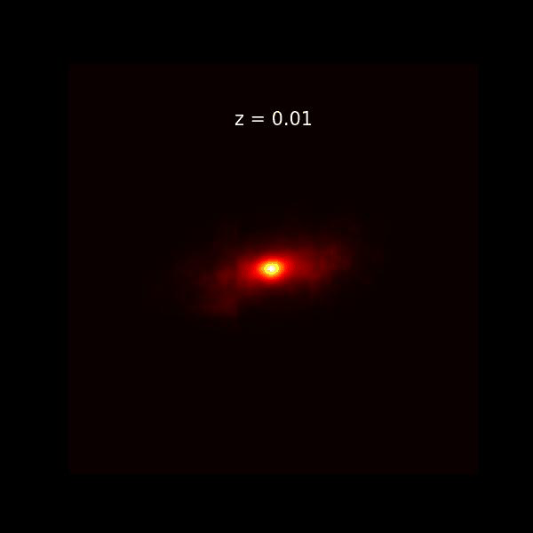
Case Study
Generating galaxy shapes from redshift images
Notes:
Case Study: Generating Galaxy Shapes from Redshift Images
Let’s consider a practical example using denoising autoencoders to generate clear galaxy shapes from redshift images. The attached image is an animation that shows the progression of a redshift image. Redshift images often have noise and distortions that obscure the details of galaxy shapes, making it challenging to analyze the structure and morphology of galaxies.
Step-by-Step Process:
Adding Noise:
During the training phase, noise is artificially added to clean galaxy images derived from redshift data. This noise simulates the common issues found in real redshift images, such as background noise and sensor artifacts.
Training the Denoising Autoencoder:
The noisy redshift images are fed into the autoencoder, which consists of an encoder that compresses the noisy input into a latent space and a decoder that reconstructs the image from this latent representation.
The autoencoder is trained to minimize the difference between the reconstructed images and the original clean images, learning to effectively remove the added noise.
Generating Clear Galaxy Shapes:
Once trained, the denoising autoencoder can be applied to actual noisy redshift images. The model processes these images, removing noise and enhancing the overall quality.
For example, the original noisy redshift image might show a faint and distorted galaxy shape. After processing with a denoising autoencoder, the image becomes clearer, revealing the detailed structure and morphology of the galaxy.
Benefits:
Improved Image Quality: Denoising autoencoders significantly enhance the quality of galaxy images derived from redshift data by removing noise, making it easier to analyze and interpret the data.
Preservation of Details: Unlike traditional noise reduction techniques that might blur important details, denoising autoencoders preserve the essential features of the image while removing noise.
Real-World Applications:
In real-world applications, enhancing the quality of galaxy images is crucial for various fields such as astronomy and astrophysics. Clearer images allow scientists to observe celestial objects with greater precision, leading to more accurate scientific discoveries. For instance, studying the shape and structure of galaxies, understanding their formation and evolution, and detecting rare astronomical events all benefit from high-quality, noise-free images.

Slide 25
Generative Adversarial Networks (GANs)
Adversarial training
Generator and discriminator networks
Applications:
Image synthesis
Style transfer
Data augmentation
Example:
Creating realistic images of astronomical phenomena.
Notes:
Theoretical Background:
Generative Adversarial Networks, or GANs, are a class of machine learning frameworks designed by Ian Goodfellow and his colleagues in 2014. The core idea of GANs is based on adversarial training, where two neural networks—the generator and the discriminator—compete against each other.
Generator and Discriminator Networks:
Generator:
The generator network creates synthetic data from random noise. It learns to produce data that resembles the real data it has been trained on. Initially, the generator's outputs are quite poor, but they improve over time as it learns from the discriminator's feedback.
Discriminator:
The discriminator network evaluates the data it receives, distinguishing between real data (from the training set) and fake data (produced by the generator). It outputs a probability indicating whether the input data is real or fake.
Adversarial Training:
The two networks are trained simultaneously in a zero-sum game: the generator tries to create data that the discriminator cannot distinguish from real data, while the discriminator tries to get better at identifying fake data. This adversarial process drives both networks to improve until the generator produces highly realistic data.

Slide 26
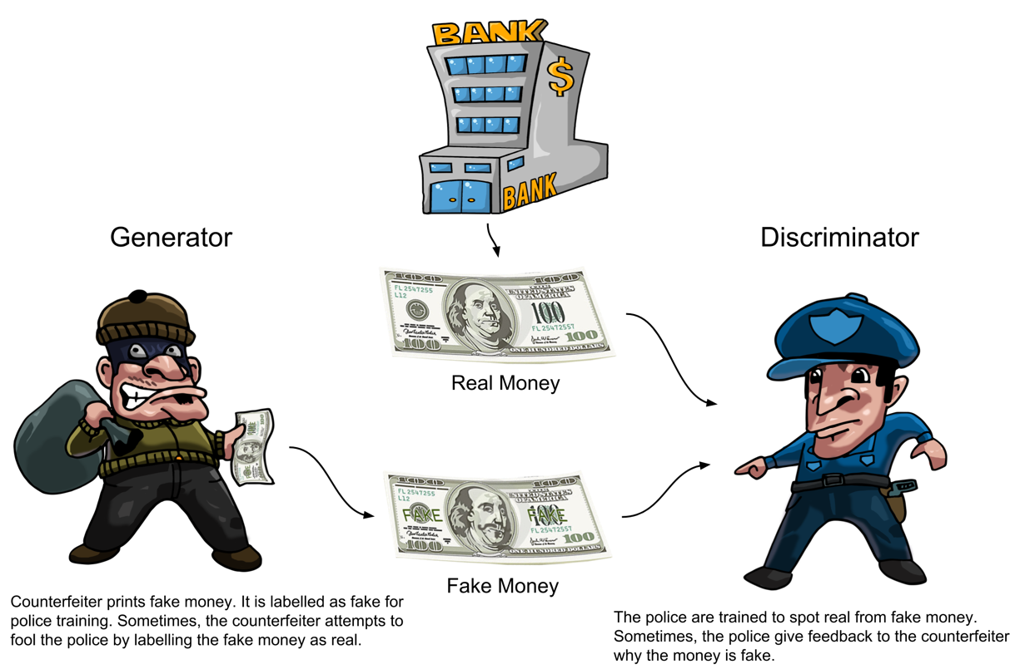
Generative Adversarial Networks (GANs)

Slide 27
Generative Adversarial Networks (GANs)
Applications:
Image Synthesis:
GANs can generate high-quality, realistic images from random noise. This capability is used in various applications, including creating synthetic faces, landscapes, and other images that look remarkably real. For instance, GANs can be used to generate images of astronomical phenomena that are difficult to capture with telescopes due to limitations like distance or environmental conditions.
Notes:
.

Slide 28
Generative Adversarial Networks (GANs)
Applications:
Style Transfer:
GANs can be used for style transfer, where the style of one image is applied to another. For example, GANs can transform a photograph into the style of a famous painting, blending the content of the original image with the artistic style of the target image. This has applications in art, entertainment, and marketing.

Slide 29
Generative Adversarial Networks (GANs)
Applications:
Data Augmentation:
GANs can generate additional training data to augment existing datasets. This is particularly useful in scenarios where acquiring new data is expensive or time-consuming. For example, in medical imaging, GANs can generate realistic images to augment the training set, improving the performance of diagnostic models.
Notes:
Example:
One practical example of using GANs is creating realistic images of astronomical phenomena. In astronomy, capturing images of distant celestial objects can be challenging due to factors like limited telescope resolution and interference from Earth's atmosphere. GANs can generate high-resolution images of these phenomena based on existing low-resolution or incomplete data. This can help astronomers study distant galaxies, nebulae, and other celestial objects in greater detail, enhancing our understanding of the universe.realistic data.

Slide 30
Attention Mechanisms
Attention mechanisms are a powerful concept in deep learning that allow models to focus on specific parts of the input data.
For example, when analyzing an image, certain regions may contain more crucial information (like the presence of specific objects) than others
. Attention mechanisms enable the model to prioritize these regions, leading to better performance in tasks such as image recognition and description.
Notes:
Attention mechanisms are a powerful concept in deep learning that allow models to focus on specific parts of the input data. This is especially useful when processing complex data where certain parts are more relevant than others. By assigning different weights to different parts of the input, attention mechanisms help the model concentrate on the most important features.
For example, when analyzing an image, certain regions may contain more crucial information (like the presence of specific objects) than others. Attention mechanisms enable the model to prioritize these regions, leading to better performance in tasks such as image recognition and description.
Transformers:
Transformers are a type of model architecture that rely heavily on attention mechanisms. They were initially developed for natural language processing tasks but have proven to be highly effective in various vision tasks as well. The core idea behind transformers is the self-attention mechanism, which allows the model to consider the relationships between different parts of the input data simultaneously.
In the context of image analysis, transformers can analyze different regions of an image in parallel, making them more efficient and effective than traditional sequential models. This capability is particularly useful for tasks like image captioning, where the model needs to generate descriptive text based on the visual content of the image.

Slide 31
Attention Mechanisms
Transformers:
Transformers are a type of model architecture that rely heavily on attention mechanisms.
In the context of image analysis, transformers can analyze different regions of an image in parallel, making them more efficient and effective than traditional sequential models such as Recurrent Neural Networks.
Notes:
Transformers:
Transformers are a type of model architecture that rely heavily on attention mechanisms. They were initially developed for natural language processing tasks but have proven to be highly effective in various vision tasks as well. The core idea behind transformers is the self-attention mechanism, which allows the model to consider the relationships between different parts of the input data simultaneously.

Slide 32
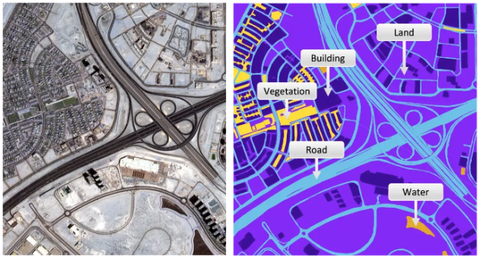
Attention Mechanisms
Case Study: Image Captioning for Satellite Imagery
Notes:
Case Study: Image Captioning for Satellite Images
Let’s consider a practical example using the attached satellite images to illustrate the application of attention mechanisms and transformers for image captioning.
Example Scenario:
The attached image on the left is a satellite view of an urban area with a complex road network, buildings, and various types of land cover. The image on the right is a labeled version of the same satellite image, indicating different regions such as buildings, roads, vegetation, land, and water.
Step-by-Step Process:
Feature Extraction:
The satellite image is passed through convolutional layers to extract high-level features representing different parts of the image. These features capture details about the various regions, such as roads, buildings, and vegetation.
Application of Self-Attention:
The self-attention mechanism within the transformer model computes attention scores for each feature, determining how much focus each part of the image should receive.
For example, regions containing roads, buildings, and water bodies might receive higher attention scores compared to less significant areas.
Generating the Caption:
Using the weighted features from the self-attention mechanism, the transformer generates a caption that describes the image.
For instance, the generated caption might be, "An urban area with a complex road network, surrounded by residential buildings, vegetation, and a water body."
Benefits:
Accuracy: Attention mechanisms ensure that the model focuses on relevant parts of the image, improving the accuracy of the generated captions.
Contextual Understanding: By analyzing relationships between different regions, transformers provide a comprehensive and contextually relevant description.
Real-World Applications:
Accurate captioning of satellite images can be incredibly valuable for various tasks such as urban planning, environmental monitoring, and disaster response. For instance, during a natural disaster like a flood, attention mechanisms can help models generate precise descriptions of affected areas, aiding in efficient disaster response and resource allocation.

Slide 33
Satellite Imagery Segmentation with U-Net
Dividing satellite images into distinct regions
Identifying features such as vegetation, buildings, roads, and water bodies
Notes:
Satellite Imagery Segmentation:
Satellite imagery segmentation involves dividing a satellite image into multiple segments or regions, each representing a specific feature or object within the image. This technique is crucial for analyzing and interpreting various components of the Earth's surface captured in satellite images. The segmentation process helps in identifying and categorizing different land cover types, such as vegetation, urban areas, roads, and water bodies.

Slide 34
U-Net
Convolutional network for image segmentation
Initially developed for biomedical image segmentation
Notes:
U-Net is a convolutional network architecture specifically designed for image segmentation tasks. It was initially developed for biomedical image segmentation but has proven to be highly effective in other fields, including satellite imagery analysis. The U-Net architecture consists of an encoder (downsampling path) and a decoder (upsampling path), connected by a bottleneck. This structure allows the network to capture both the context and precise localization of features within an image.

Slide 35
U-Net Applications
Environmental monitoring
Urban planning
Disaster management
Notes:
Satellite imagery segmentation using U-Net has several important applications:
Environmental Monitoring:
By segmenting different land cover types, we can monitor changes in vegetation, track deforestation, and assess the health of ecosystems.
Urban Planning:
Segmentation helps in analyzing urban growth patterns, identifying infrastructure, and planning new developments.
Disaster Management:
Accurate segmentation of satellite images can assist in disaster response by identifying affected areas, such as regions impacted by floods, wildfires, or earthquakes.

Slide 36
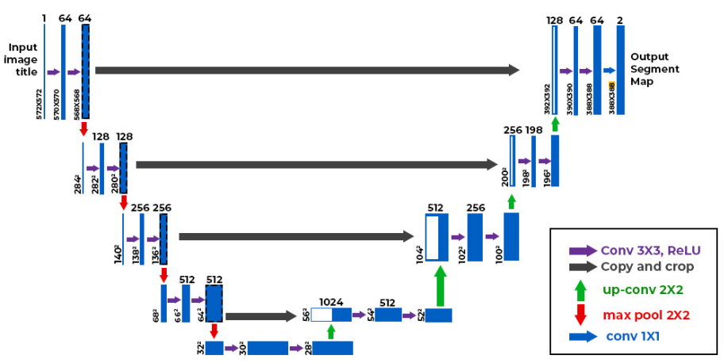
U-Net Architecture
Designed for image segmentation
Encoder-decoder structure
Notes:
U-Net is a specialized convolutional neural network (CNN) architecture designed specifically for image segmentation tasks. It was initially developed for biomedical image segmentation but has since been adapted for various applications, including satellite imagery analysis. The key feature of U-Net is its ability to provide precise segmentation by capturing both the context and localization of features within an image.
Key Components:
Encoder (Downsampling Path): Extracts features from the input image through a series of convolutional and pooling layers, progressively reducing the spatial dimensions while increasing the depth.
Decoder (Upsampling Path): Reconstructs the segmented image by upsampling the feature maps, combining high-level and low-level features to provide precise localization.
Bottleneck: Connects the encoder and decoder, representing the most compressed and informative representation of the input image.
Skip Connections: Directly connect corresponding layers in the encoder and decoder, allowing the model to combine low-level spatial information with high-level features.

Slide 37
Differences from Standard CNN:
Context and Localization:
Standard CNN: Primarily focuses on feature extraction and classification tasks, often losing spatial information due to multiple pooling layers.
U-Net: Maintains spatial information throughout the network by combining contextual information (from the encoder) with precise localization (from the decoder), making it ideal for segmentation tasks.
Notes:
Context and Localization:
Standard CNN:
Standard CNNs are primarily designed for tasks like image classification, where the goal is to identify the presence of objects within an image. They excel at extracting features through multiple convolutional and pooling layers.
However, as the network goes deeper, the pooling layers reduce the spatial dimensions of the feature maps, leading to a loss of precise spatial information. This makes it challenging to perform tasks that require precise localization, such as image segmentation.
U-Net:
U-Net, on the other hand, is specifically designed to maintain spatial information throughout the network. It achieves this by combining contextual information from the encoder with precise localization from the decoder.
The encoder path extracts features and reduces spatial dimensions, similar to a standard CNN, but the decoder path upscales these features to restore the original spatial dimensions. This ensures that the segmentation map retains both context and precise boundaries.

Slide 38
Differences from Standard CNN:
Symmetric Architecture:
Standard CNN: Typically follows a straightforward hierarchical structure, focusing on downsampling and feature extraction.
U-Net: Features a symmetric architecture with an equal number of downsampling and upsampling layers, enabling the network to reconstruct the input image's spatial dimensions accurately.
Notes:
Upscaling Spatial Locations:
The primary function of the U-Net decoder is to upscale the feature maps obtained from the encoder to the original image dimensions. This is achieved through several techniques:
Transposed Convolutions (Deconvolutions):
Definition:
Transposed convolutions, also known as deconvolutions or up-convolutions, are used to increase the spatial dimensions of the feature maps.
How They Work:
Unlike standard convolutions that reduce spatial dimensions, transposed convolutions apply a filter to the input feature map in such a way that the output has a larger spatial dimension.
This process effectively "reverses" the downsampling done by the encoder, allowing the feature maps to be upscaled.
Example:
If the input to a transposed convolution layer is a 2x2 feature map, the output might be a 4x4 feature map, depending on the stride and padding used.
Upsampling Layers:
Definition:
Upsampling layers are another method used to increase the spatial dimensions of feature maps.
Common Techniques:
Nearest Neighbor Upsampling: Each pixel is replicated to fill a larger area.
Bilinear Interpolation: Uses linear interpolation to upscale the image, providing a smoother result than nearest neighbor.
Application:
These layers are often used in conjunction with transposed convolutions to further refine the upscaled feature maps.
Combining Features from Encoder:
A key aspect of the U-Net decoder is its ability to combine features from the encoder using skip connections. This helps in preserving fine-grained spatial information that might be lost during the downsampling process.
Skip Connections:
Definition:
Skip connections directly link corresponding layers in the encoder and decoder.
How They Work:
Features from an earlier layer in the encoder are concatenated with features from a corresponding layer in the decoder.
This allows the decoder to utilize both high-level features from the encoder and detailed spatial information.
Benefits:
Preserves fine details and improves the accuracy of the segmentation map.
Helps in reconstructing the original image dimensions more effectively.
Example:
Suppose we have a feature map from a layer in the encoder that captures detailed edges of objects. By using a skip connection, this feature map is directly concatenated with a corresponding layer in the decoder. The decoder then processes this combined information to produce a more accurate segmentation map.
Restoring Original Image Dimensions:
The final goal of the U-Net decoder is to restore the feature maps to the same spatial dimensions as the original input image. This ensures that the output segmentation map aligns perfectly with the input image, allowing for precise segmentation of different regions.
Process:
Sequential Upscaling:
The feature maps are progressively upscaled through multiple layers of transposed convolutions and upsampling layers.
Integration with Skip Connections:
At each step, the feature maps from the decoder are combined with corresponding feature maps from the encoder through skip connections.
Final Segmentation Map:
The final layer of the decoder produces a segmentation map that has the same dimensions as the original input image, with each pixel labeled according to the segmented regions.

Slide 39
Differences from Standard CNN:
Skip Connections:
Standard CNN: Generally does not include skip connections, leading to potential loss of spatial information.
U-Net: Incorporates skip connections that directly link corresponding layers in the encoder and decoder, preserving fine-grained details and enhancing the segmentation accuracy.

Slide 40
How the U-Net Encoder Works
Key Components:
Convolutional layers
Pooling layers
Feature extraction

Slide 41
How the U-Net Encoder Works
Extracting features
Reducing spatial dimensions
Preserving context
Notes:
The primary function of the U-Net encoder is to extract meaningful features from the input image. This is achieved through a series of convolutional layers, each designed to capture different levels of detail.
Convolutional Layers:
Definition:
Convolutional layers apply a set of filters to the input image to produce feature maps. Each filter detects specific features such as edges, textures, and shapes.
How They Work:
The convolution operation involves sliding the filter over the input image and performing element-wise multiplication and summation, resulting in a feature map.
Multiple filters are used in each layer to capture a variety of features.
Example:
The first convolutional layer might detect edges and simple textures, while deeper layers capture more complex patterns and structures.
As the encoder processes the input image, it progressively reduces the spatial dimensions while increasing the depth of the feature maps. This helps in capturing more abstract features and reducing the computational complexity.
Pooling Layers:
Definition:
Pooling layers reduce the spatial dimensions of the feature maps by downsampling, typically using max pooling or average pooling.
Max Pooling:
Max pooling selects the maximum value from each region of the feature map, preserving the most significant features.
Average Pooling:
Average pooling computes the average value of each region, providing a smoothed representation.
How They Work:
Pooling layers follow convolutional layers to downsample the feature maps, reducing their width and height while maintaining the depth.
Example:
A 2x2 max pooling layer applied to a 4x4 feature map will produce a 2x2 output by selecting the maximum value from each 2x2 region.
Preserving Context:
While the encoder reduces the spatial dimensions, it preserves the context of the input image by capturing hierarchical features at multiple levels of abstraction. This contextual information is crucial for accurate segmentation.
Process:
Sequential Convolutions and Pooling:
The input image is passed through several convolutional layers, each followed by a pooling layer. This process extracts increasingly abstract features while reducing the spatial dimensions.
Hierarchical Feature Extraction:
Early layers capture low-level features (e.g., edges), while deeper layers capture high-level features (e.g., shapes and patterns).
Feature Maps:
At each stage, the feature maps become smaller in spatial dimensions but deeper, containing more abstract and complex features.
Example:
The first few layers of the encoder might capture edges and textures, while later layers capture shapes and more complex structures. For example, in a satellite image, early layers might detect roads and buildings, while deeper layers capture entire urban areas and land cover patterns.

Slide 42
How the U-Net Decoder Works
U-Net Decoder:
Upscaling spatial locations
Combining features from encoder
Restoring original image dimensions
Notes:
Upscaling Spatial Locations:
The primary function of the U-Net decoder is to upscale the feature maps obtained from the encoder to the original image dimensions. This is achieved through several techniques:
Transposed Convolutions (Deconvolutions):
Definition:
Transposed convolutions, also known as deconvolutions or up-convolutions, are used to increase the spatial dimensions of the feature maps.
How They Work:
Unlike standard convolutions that reduce spatial dimensions, transposed convolutions apply a filter to the input feature map in such a way that the output has a larger spatial dimension.
This process effectively "reverses" the downsampling done by the encoder, allowing the feature maps to be upscaled.
Example:
If the input to a transposed convolution layer is a 2x2 feature map, the output might be a 4x4 feature map, depending on the stride and padding used.
Upsampling Layers:
Definition:
Upsampling layers are another method used to increase the spatial dimensions of feature maps.
Common Techniques:
Nearest Neighbor Upsampling: Each pixel is replicated to fill a larger area.
Bilinear Interpolation: Uses linear interpolation to upscale the image, providing a smoother result than nearest neighbor.
Application:
These layers are often used in conjunction with transposed convolutions to further refine the upscaled feature maps.
Combining Features from Encoder:
A key aspect of the U-Net decoder is its ability to combine features from the encoder using skip connections. This helps in preserving fine-grained spatial information that might be lost during the downsampling process.
Skip Connections:
Definition:
Skip connections directly link corresponding layers in the encoder and decoder.
How They Work:
Features from an earlier layer in the encoder are concatenated with features from a corresponding layer in the decoder.
This allows the decoder to utilize both high-level features from the encoder and detailed spatial information.
Benefits:
Preserves fine details and improves the accuracy of the segmentation map.
Helps in reconstructing the original image dimensions more effectively.
Example:
Suppose we have a feature map from a layer in the encoder that captures detailed edges of objects. By using a skip connection, this feature map is directly concatenated with a corresponding layer in the decoder. The decoder then processes this combined information to produce a more accurate segmentation map.
Restoring Original Image Dimensions:
The final goal of the U-Net decoder is to restore the feature maps to the same spatial dimensions as the original input image. This ensures that the output segmentation map aligns perfectly with the input image, allowing for precise segmentation of different regions.
Process:
Sequential Upscaling:
The feature maps are progressively upscaled through multiple layers of transposed convolutions and upsampling layers.
Integration with Skip Connections:
At each step, the feature maps from the decoder are combined with corresponding feature maps from the encoder through skip connections.
Final Segmentation Map:
The final layer of the decoder produces a segmentation map that has the same dimensions as the original input image, with each pixel labeled according to the segmented regions.

Slide 43
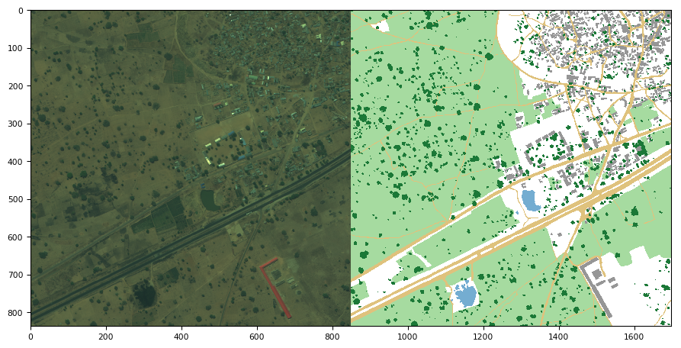
U-Net Case Study:
Segmenting regions of interest in satellite images
Notes:
he attached image illustrates a practical example of using U-Net for segmenting regions of interest in satellite images. The left side of the image shows the original satellite image, while the right side displays the segmented map. Different colors represent various features such as vegetation, buildings, roads, and water bodies.
Step-by-Step Process:
Data Preparation:
Collect a dataset of satellite images with annotated regions of interest. These annotations typically mark the boundaries of different land cover types.
Preprocess the images and annotations to standardize the input size and format for training the U-Net model.
Training the U-Net Model:
The U-Net model is trained on the annotated dataset. The encoder part of the U-Net extracts features from the input image by progressively downsampling it, while the decoder part reconstructs the segmented output by upsampling.
The model learns to minimize the difference between the predicted segmentation and the ground truth annotations.
Segmentation of New Images:
Once trained, the U-Net model can be applied to new satellite images to segment regions of interest.
For example, given an input image of an urban area, the U-Net model will output a segmented image highlighting buildings, roads, vegetation, and water bodies.
Benefits:
Precision: U-Net provides precise segmentation of various land cover types, which is essential for detailed analysis and classification.
Efficiency: The architecture allows for fast processing of images, making it suitable for large-scale satellite image analysis.
Real-World Applications:
Accurate segmentation of satellite images is critical for various research and practical applications. For instance, identifying and cataloging land cover types in large geographical areas, monitoring urban expansion, and assessing environmental changes all rely on precise image segmentation. U-Net’s ability to accurately and efficiently segment images makes it an invaluable tool in these efforts.
Example:
Using the image provided from the Deep U-Net for Satellite Image Segmentation GitHub repository, we can see how U-Net is applied to segment different regions in a satellite image. The left side of the image shows the original satellite image, while the right side displays the segmented map with different colors representing various features such as vegetation, buildings, roads, and water bodies.

Slide 44
Difference Between a Variational Autoencoder (VAE) and U-Net
Variational Autoencoder (VAE)
VAEs are generative models designed to learn a probabilistic distribution over input data, allowing for the generation of new data samples similar to the input data.
:

Slide 45
Difference Between a Variational Autoencoder (VAE) and U-Net
Probabilistic Nature: The encoder outputs a distribution (mean and variance) rather than a single point. This allows the model to generate new data by sampling from this distribution.
Generative Capabilities: Can generate new, similar data points by sampling from the learned latent distribution.
Reconstruction and Regularization: Includes a reconstruction loss (to ensure the output matches the input) and a KL divergence loss (to regularize the latent space).
:

Slide 46
Difference Between a Variational Autoencoder (VAE) and U-Net
Can generate new data similar to the training data.
Learns a continuous and smooth latent space.

Slide 47
Difference Between a Variational Autoencoder (VAE) and U-Net
U-Net is specifically designed for image segmentation tasks, providing pixel-wise predictions to label each pixel in the input image.

Slide 48
Difference Between a Variational Autoencoder (VAE) and U-Net
U-Net is specifically designed for image segmentation tasks, providing pixel-wise predictions to label each pixel in the input image.

Slide 49
Difference Between a Variational Autoencoder (VAE) and U-Net
U-Net is specifically designed for image segmentation tasks, providing pixel-wise predictions to label each pixel in the input image.

Slide 50
Difference Between a Variational Autoencoder (VAE) and U-Net
Feature | VAE | U-Net
Purpose | Data generation, anomaly detection, representation learning | Image segmentation
Architecture | Encoder, latent space, decoder | Encoder (contracting path), bottleneck, decoder (expansive path), skip connections
Key Features | Probabilistic modeling, latent space sampling, generative capabilities | Symmetric structure, skip connections, precise localization
Use Cases | Data generation, anomaly detection, dimensionality reduction | Biomedical image segmentation, satellite imagery segmentation
Strengths | Generative modeling, continuous latent space | High-quality segmentation, retains fine details
Weaknesses | Complex training, potential lower reconstruction quality | Computationally intensive, not designed for generative tasks

